Slide 1
Constraints in Representation Learning CAS AML 2024
Dr. Mykhailo Vladymyrov
Data Science Lab
University of Bern

Slide 2


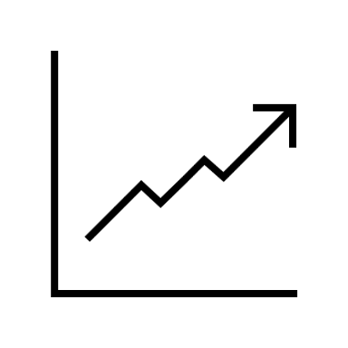
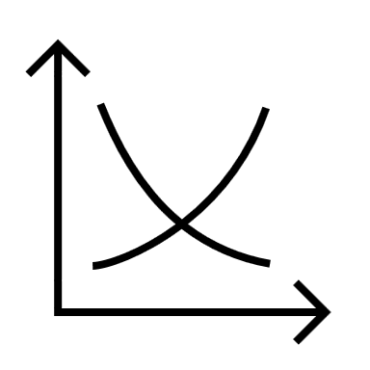
Representation learning
Representation Learning is an approach in machine learning where algorithms create new data representations from the data, that are easier to process.
Melting rate
Temperature
…
Poetic description
Prediction
Anomaly discovery
…
Understanding system dynamics
Notes:
Easier – to who and for which tasks?

Slide 3
Representation learning
Representation Learning is an approach in machine learning where algorithms create new data representations from the data, that are easier to process.
These representations can be designed for interpretability, reveal hidden features, or be used for transfer learning.
Melting rate
Temperature
…
Poetic description
Prediction
Anomaly discovery
…
Understanding system dynamics
Notes:
Easier – to who and for which tasks?

Slide 4
The data – defines “quality” of the representation
The model learns patterns in your data.
If the main pattern of your data is variety of noise features – this will be dominant feature learned.
If your dataset is too small – the model would learn features specific to your samples, rather than to the distribution they are sampled from.

Slide 5
The algorithm – defines properties of the representation

Slide 6
The algorithm – defines properties of the representation
Let’s discuss what does this imply for:
Classification model
AE (and VAE, VQVAE)
DDM
Notes:
CM – L features useful for a specific task, not encode all Original features.
AE – variability between training population described by L.f., matching o.f. distribution
DDM – likelihood gradient in the o.f. space

Slide 7
The task – defines desired property of the representation

Slide 8
The task – defines desired property of the representation
e.g. consider the difference:
AE with L2 vs L1 vs Perceptive Loss
AE vs VAE vs VQVAE
DDM in original vs latent space
Notes:
CM – L features useful for a specific task, not encode all Original features.
AE – variability between training population described by L.f., matching o.f. distribution
DDM – likelihood gradient in the o.f. space

Slide 9
So how can we steer it?
Constraints
Transformations
Conditions

Slide 10
Constraints

Slide 11
Constraints
Size of representation
Statistical properties – e.g. using variational inference
Space in which representations “Live”:
Vector
Matrix
Vector field
Notes:
VAE – continuous L.f., probability distribution
VQVAE - variability between training population described by set of discrete L.f.

Slide 12
Transformations

Slide 13
Input transformations
Augmentations:
Translation/rotation
Noise
Derivate explicit representation

Slide 14
Representation transformations
Sampling from modelled distribution
Equivariance
Invariance

Slide 15
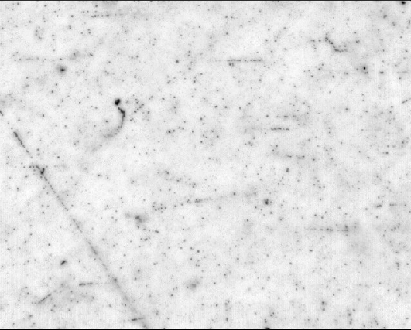
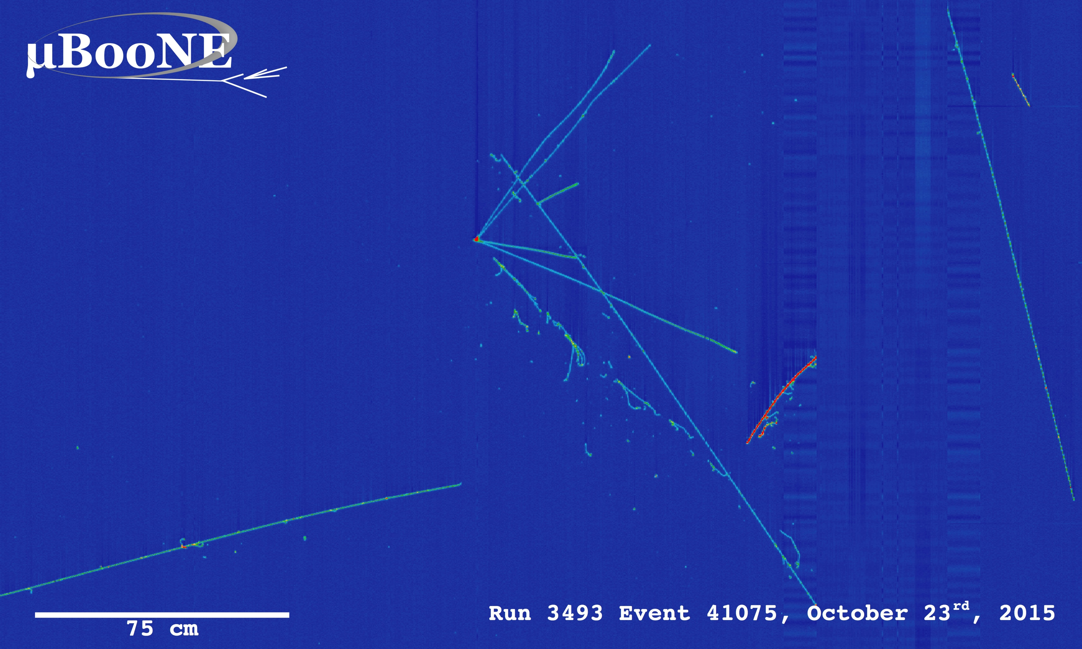
Tracking: finding lines
Algorithms:
Leverage small part of available information
Tedious adaptation to new conditions
Supervised Machine Learning
Leverage all low-level information
Requires labeled data / training on simulations
Unsupervised Machine Learning
Leverage all low-level information
No / small amount of labeled data
190 um

Slide 16
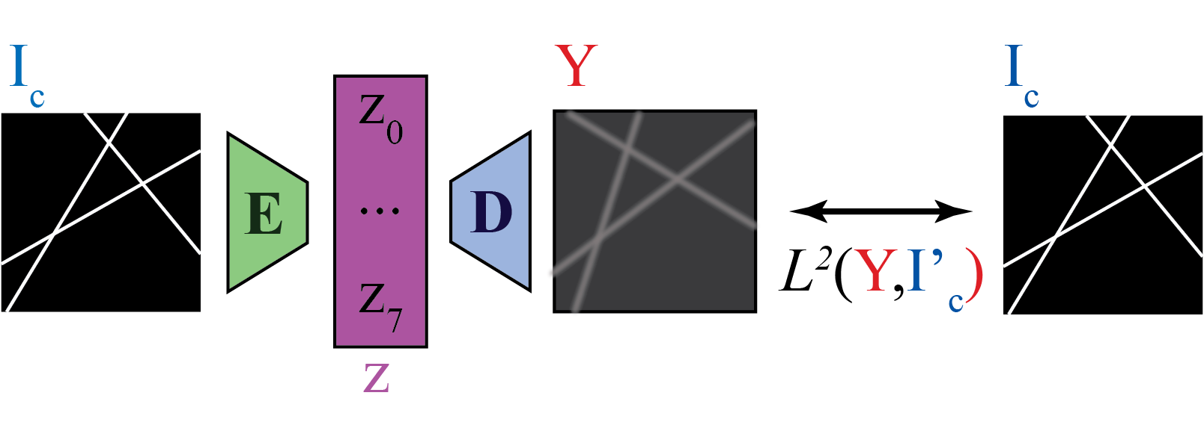
Proposed model
$z_{i}$– parameters that shall correspond to the i^{th} track

Slide 17
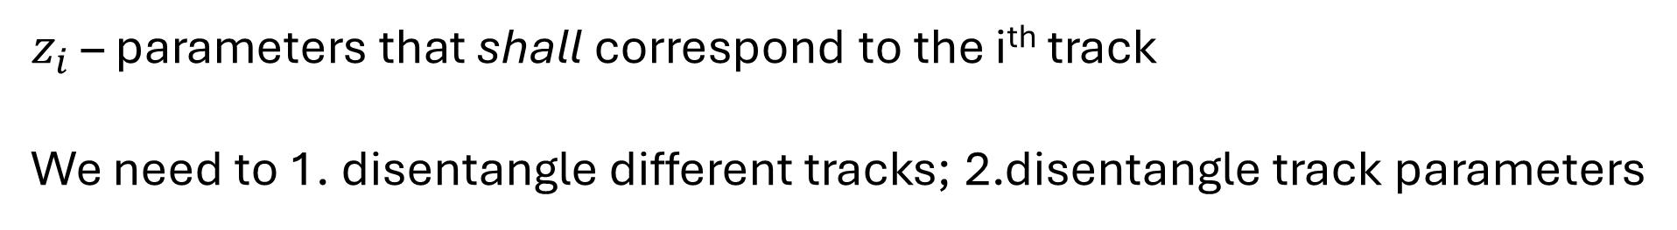
Proposed model
$z_{i}$ – parameters that shall correspond to the i^{th} track
We need to 1. disentangle different tracks; 2.disentangle track parameters

Slide 18
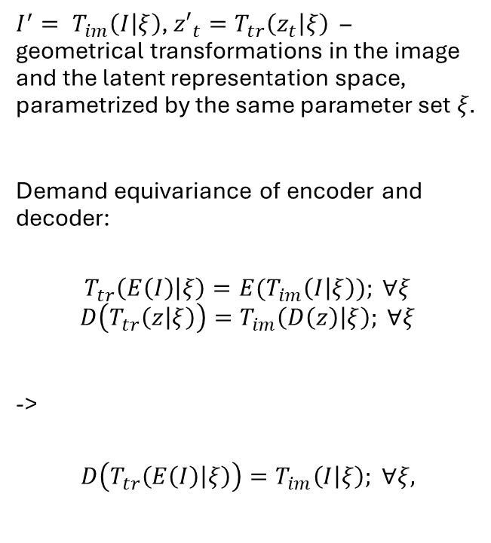
Equivariance constraint
$I^{′}= T_{im}\left(I | ξ\right)$, $z′_{t}=T_{tr}\left(z_{t} | ξ\right)$ – geometrical transformations in the image and the latent representation space, parametrized by the same parameter set $ξ.$
Demand equivariance of encoder and decoder:
$$T_{tr}\left(E\left(I\right) | ξ\right)={E(T}_{im}\left(I | ξ\right)); ∀ξ$$
$$D\left(T_{tr}\left(z | ξ\right)\right)=T_{im}\left(D\left(z\right) | ξ\right); ∀ξ$$
->
$$D\left(T_{tr}\left(E\left(I\right) | ξ\right)\right)=T_{im}\left(I | ξ\right); ∀ξ,$$

Slide 19
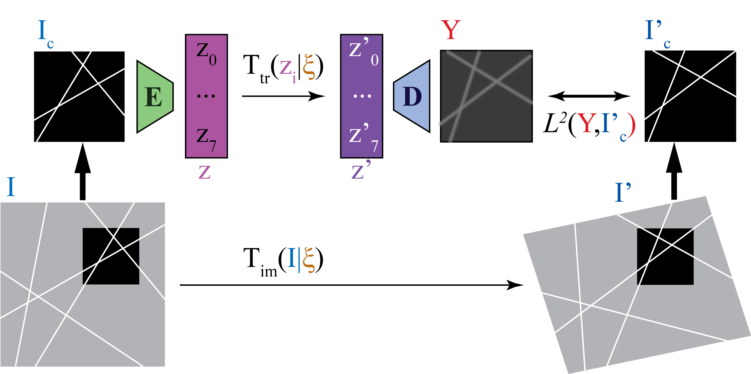
Equivariance constraint
$I^{′}= T_{im}\left(I | ξ\right)$, $z′_{t}=T_{tr}\left(z_{t} | ξ\right)$ – geometrical transformations in the image and the latent representation space, parametrized by the same parameter set $ξ.$
Demand equivariance of encoder and decoder:
$$T_{tr}\left(E\left(I\right) | ξ\right)={E(T}_{im}\left(I | ξ\right)); ∀ξ$$
$$D\left(T_{tr}\left(z | ξ\right)\right)=T_{im}\left(D\left(z\right) | ξ\right); ∀ξ$$
->
$$D\left(T_{tr}\left(E\left(I\right) | ξ\right)\right)=T_{im}\left(I | ξ\right); ∀ξ,$$
$$E,D=\underset{E,D}{argmin} \underset{I, ξ}{𝔼}{L^{2}\left(Y, I_{c}^{′}\right)}=\underset{E,D}{argmin} \underset{I, ξ}{𝔼}{L^{2}\left(D\left(T_{tr}\left(E\left(\left.C(I\right)\right) | ξ\right)\right), C\left(T_{im}\left(I | ξ\right)\right)\right).}$$

Slide 20
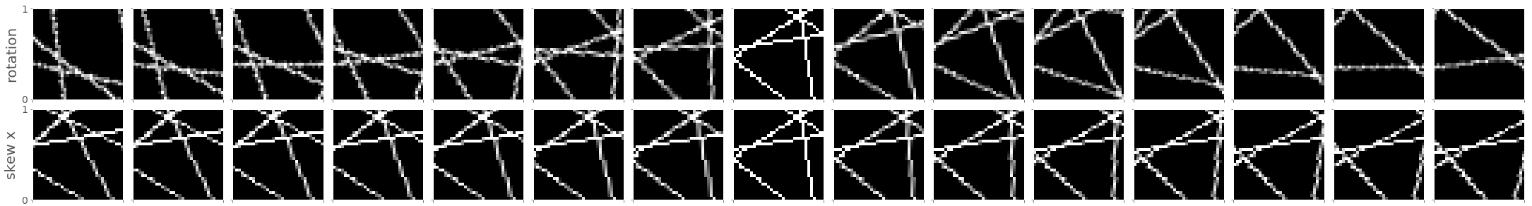
Representation transformations
Affine Transformations: rotation, translation, skew, scale
Notes:
Check values

Slide 21
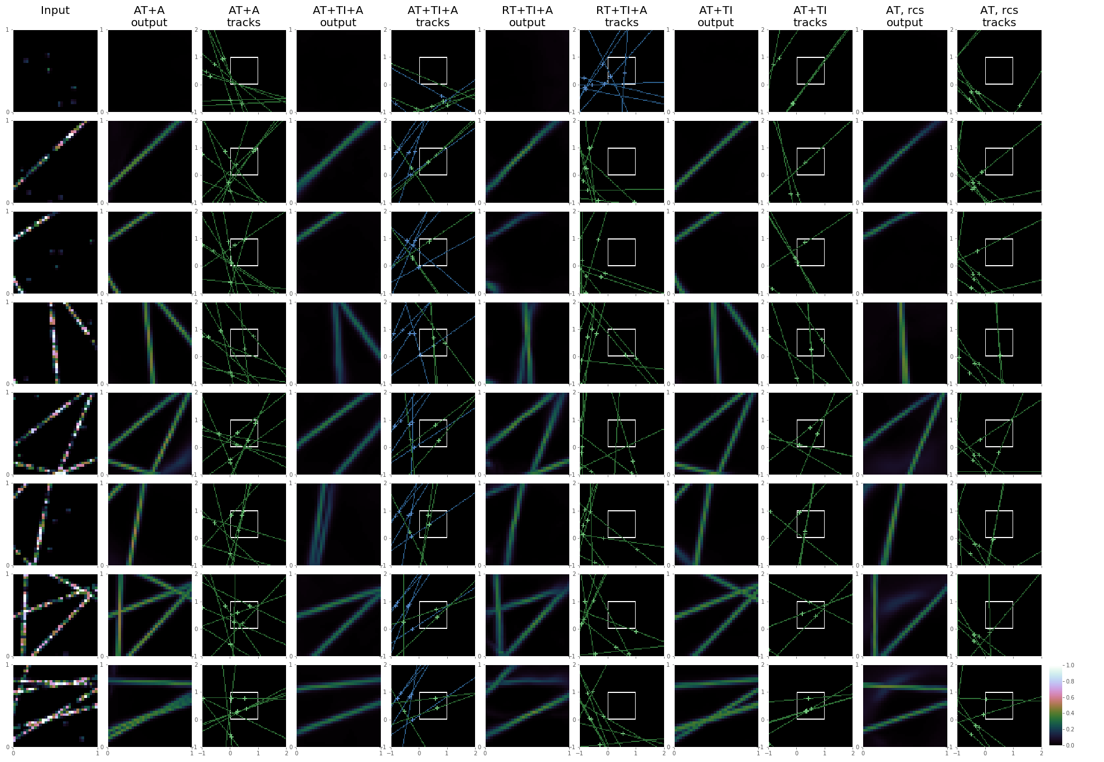
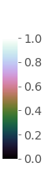
Autoencoder performance
Imposing equivariance constraint on the autoencoder under geometrical transformations in the image and latent representation domains enables the model to “discover” the existence of multiple lines in the presented images in a fully unsupervised manner.
M.Vladymyrov, A. Ariga,
Novel tracking approach based on fully-unsupervised disentanglement of the geometrical factors of variation
JINST 15 (2020) 03, P03009

Slide 22
Conditions

Slide 23

Conditions
Distribution properties
e.g. for VAE we had:
$$L=L_{rec}+\frac{1}{2}\sum_{{i=1..n}_{code}}{(σ_{i}^{2}\left(x\right)+μ_{i}^{2}\left(x\right)−1−\log{σ_{i}^{2}\left(x\right)})}$$

Slide 24

Conditions
Sparseness – like Lasso regression
Impose by augmenting the loss function:
$$L = L_{task} +λ⋅\sum_{i}{z_{i}}$$

Slide 25

Conditions
Integrity:
e.g. terms sum up to 100%:
$$L=L_{0}+λ \left(\sum_{i}{z_{i}} −1\right)$$
project on a unit sphere:
$$z_{i}→ \frac{z_{i}}{|z_{i}|}$$

Slide 26
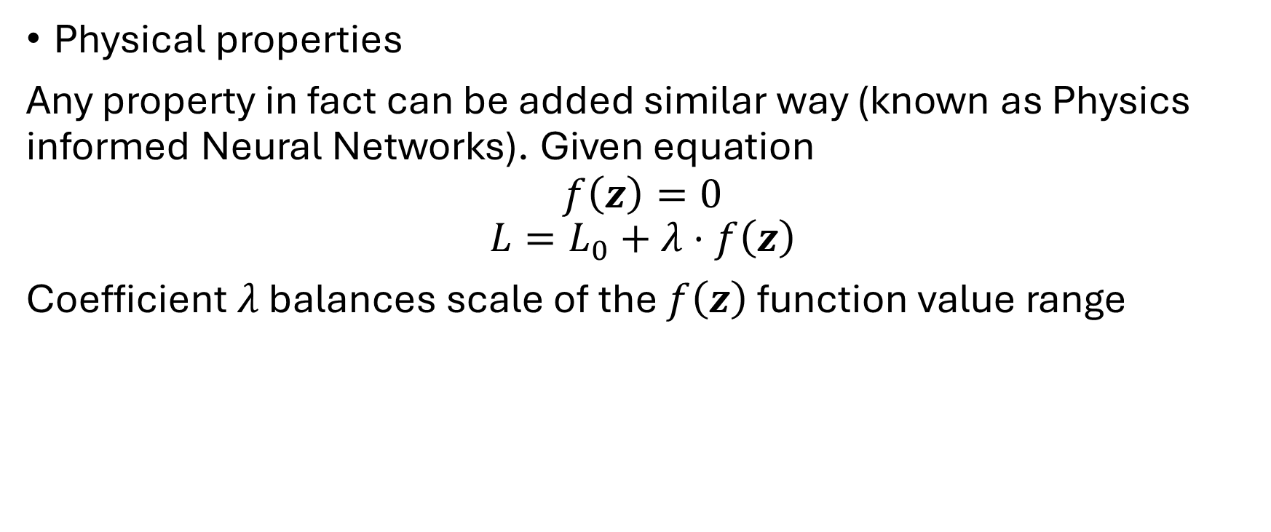
Conditions
Physical properties
Any property in fact can be added similar way (known as Physics informed Neural Networks). Given equation
$$f\left(z\right)=0$$
$$L=L_{0}+λ⋅f\left(z\right)$$
Coefficient $λ$ balances scale of the $f\left(z\right)$ function value range

Slide 27
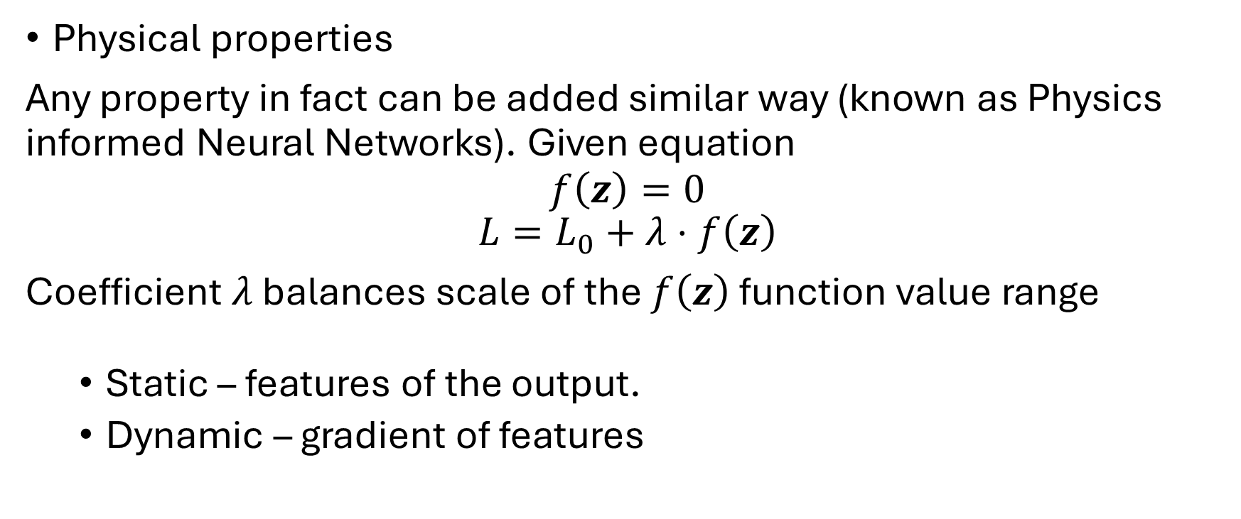
Conditions
Physical properties
Any property in fact can be added similar way (known as Physics informed Neural Networks). Given equation
$$f\left(z\right)=0$$
$$L=L_{0}+λ⋅f\left(z\right)$$
Coefficient $λ$ balances scale of the $f\left(z\right)$ function value range
Static – features of the output.
Dynamic – gradient of features

Slide 28
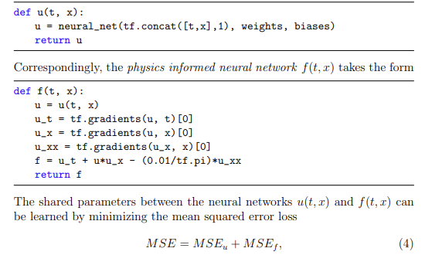


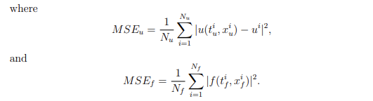
PINNs
Consider searching for a PDE solution:
arXiv:1711.10561v1

Slide 29
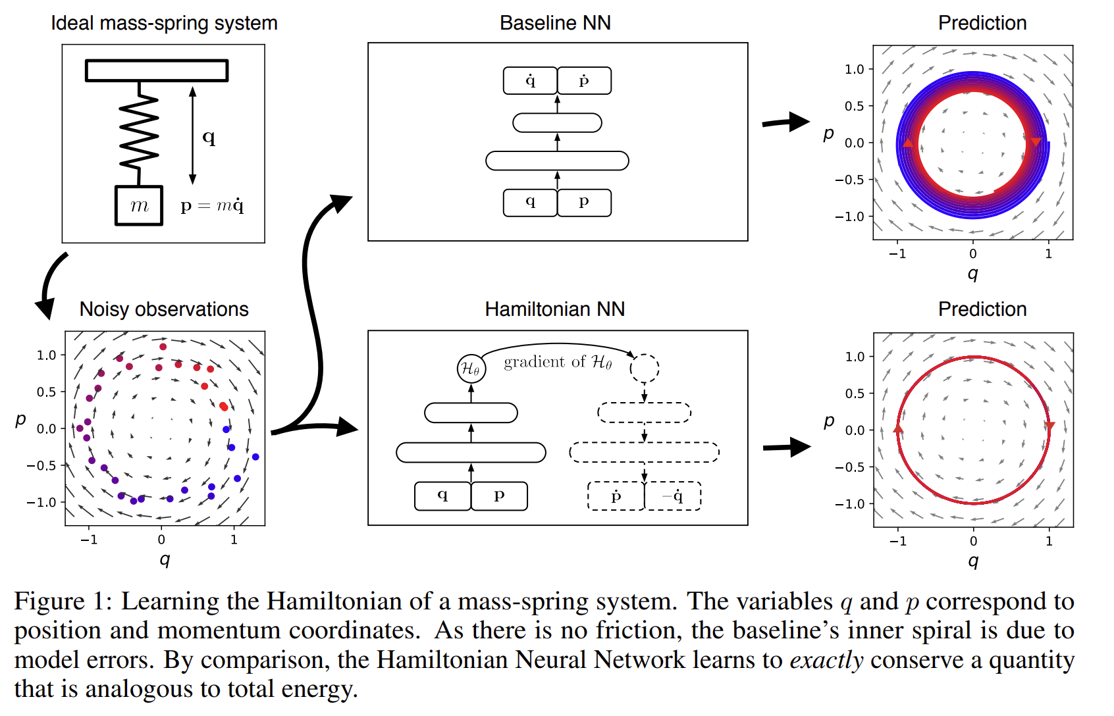

PINNs
arXiv:1906.01563v3

Slide 30
Further readings

Slide 31
PINNs:
https://arxiv.org/pdf/1906.01563
https://towardsdatascience.com/physics-informed-neural-networks-pinns-an-intuitive-guide-fff138069563
https://arxiv.org/pdf/1711.10561
NN important tools:
Normalizations: https://www.pinecone.io/learn/batch-layer-normalization/
Gradient propagation: https://mrinalwalia.medium.com/understanding-the-vanishing-gradient-problem-in-deep-learning-c648a4f16b05
Stop gradient
Interpreting learned features in CNNs:
https://distill.pub/2017/feature-visualization/
https://distill.pub/2018/building-blocks/
https://distill.pub/2018/differentiable-parameterizations/

Slide 32
Workshop
1h + 15min

Slide 33
Plan the project
What task are you attempting?
Which representations would be useful?
Which tools would you use?
Which constraints are imposed by the model?
Which conditions would you apply?

